Slide 1
National Wildlife Federation
Board Development Discussion
March 21, 2018
Notes:
40 people
8-10 board and staff members (20)—state affiliated members
20 people--Individuals from National Wildlife Federation (attorneys, lobbists)
Beforehand:
Wednesday 8am, lunch 12:45pm
12:45-1:45pm ARMY building: broadening the wildlife constituency and building power for wildlife. NWF national can help and that state to build the army. Grassroots individual member questions.
1:45pm-3:15pm ME on board development
After:
NWF ranger rick publisher

Slide 2
Notes:
Propel Services for people outside the state:
Webinars—take advantage
Online resources: governance and finance

Slide 3
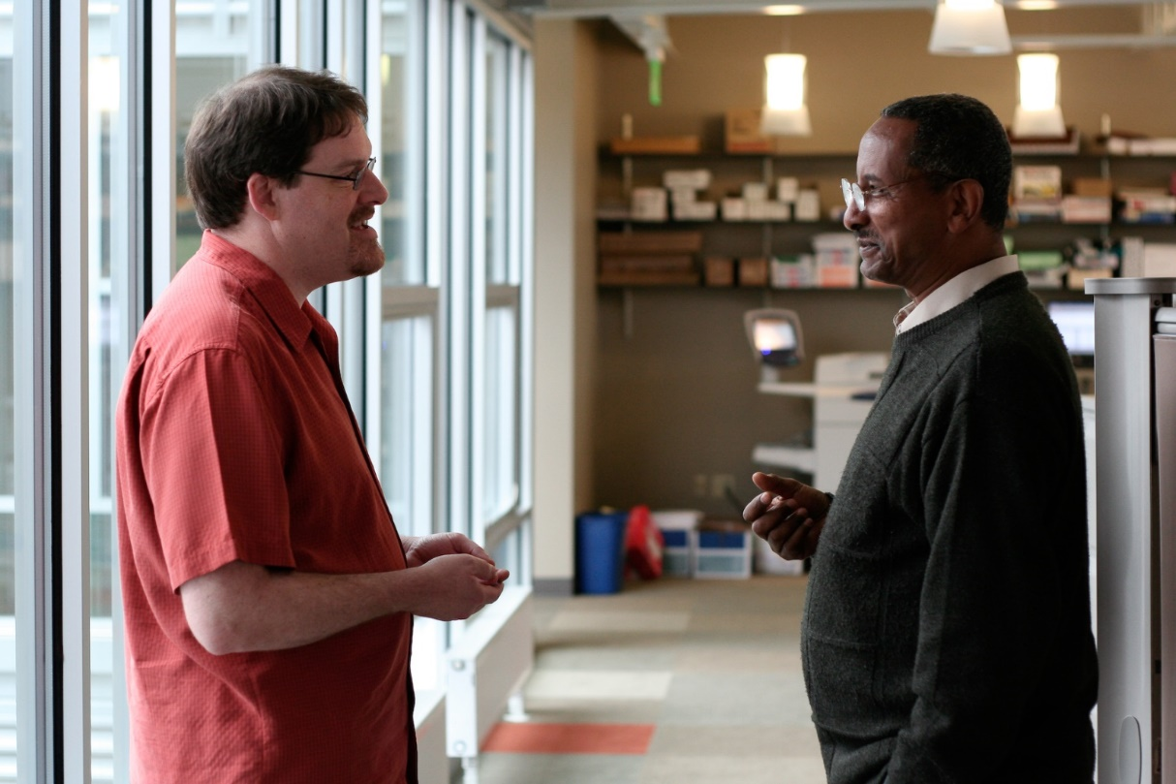
Name
State Affiliate
Profession
What does your org. need from board leadership today?
Notes:
3
Just state people—for my benefit
NWF staff we will skip

Slide 4
Agenda Flow: Board Development
Board governance basics
  Legal responsibilities of board members
  Board/staff partnership
  Board roles/responsibilities Overview
  Ensure Healthy Governance
Board Development Planning
Notes:
4

Slide 5
Fiduciary Duties of Board Members
Fiduciary = Involving Confidence or Trust
Board Members must exercise duty of…
Care “…with the care an ordinarily prudent
person…would exercise…”
Active participation, be present, written records,
ask pertinent questions
Loyalty “…put the good of the organization first and avoid
engaging in transactions with the organization
from which the director will benefit.”
Put aside personal & professional interests,
conflict of interest policy (96% of orgs have D&O insurance)
Obedience “…follow the organization’s governing
documents…comply with laws”
(Stay true to the organization’s mission)
Follow statutes, know the governing documents, know & follow
the law
From the Office of Minnesota Attorney General, Fiduciary Duties of Directors of Charitable Organizations
Notes:
5
Review

Slide 6
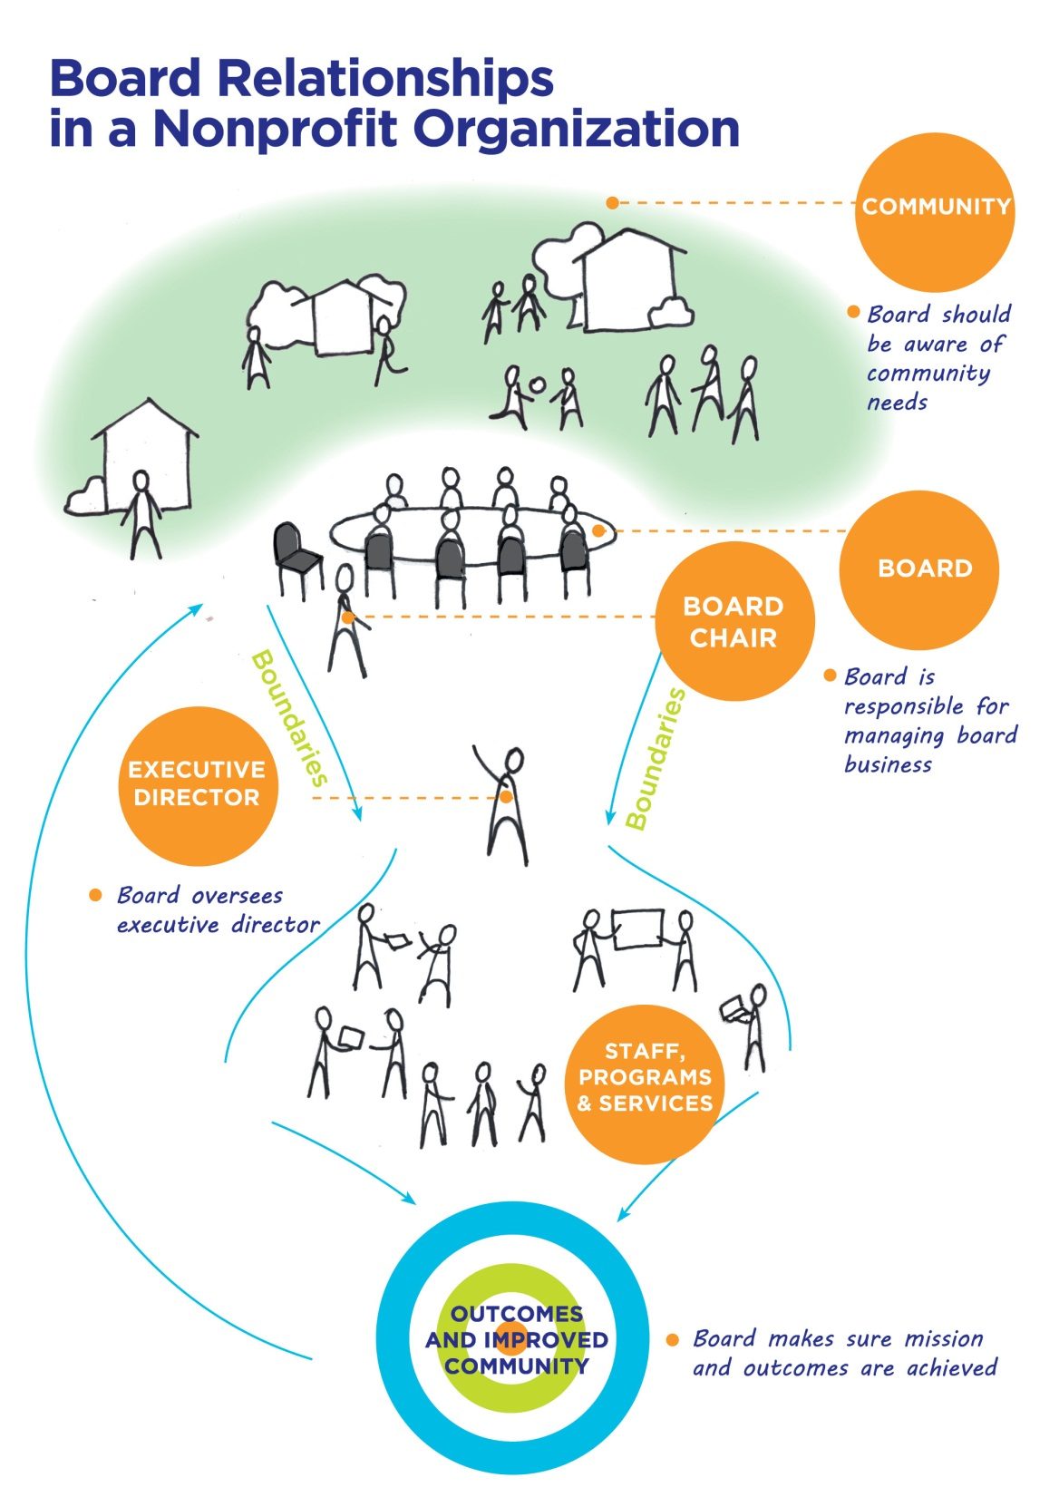
The Flow of
Board
Relationships
*Concept developed by John Carver, Policy Governance® Model
Notes:
6
Discussion: Model resonate with yours? Some have no full time staff. Some have 5-10 staff. They all have boards but the models are very different.
Board President=Board Chair

Slide 7
Board Involvement Grid
STRONG
ED displaces board
Governance = Rubber Stamping
Board/ED Collaborate
Governance= Effective
Executive Director Engagement
Going through the motions
Governance = Uninspiring meetings
Board displaces ED
Governance = Micromanagement
Board Engagement
WEAK
STRONG

Slide 8
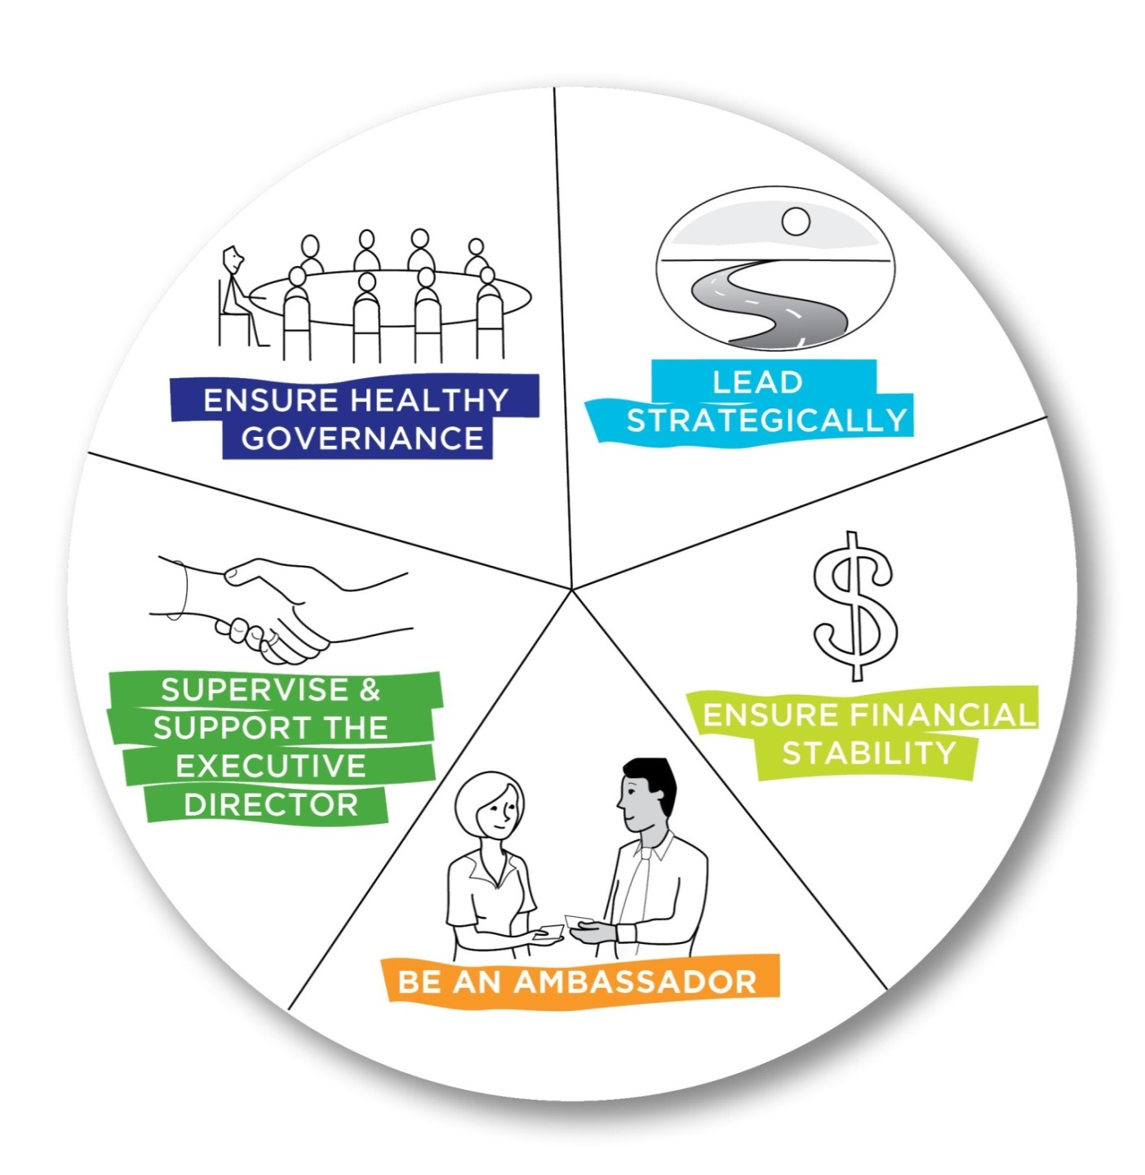
Board Member Responsibilities
Notes:
8

Slide 9

Board Development Discussion
Which two are you board most comfortable with?
Which two are your board least comfortable with?
Notes:
9
Board President & ED or pair up with organizations in similar life-stages
Kansas—does not have a staff member
Iowa—does not have an Executive Director
Oklahoma

Slide 10
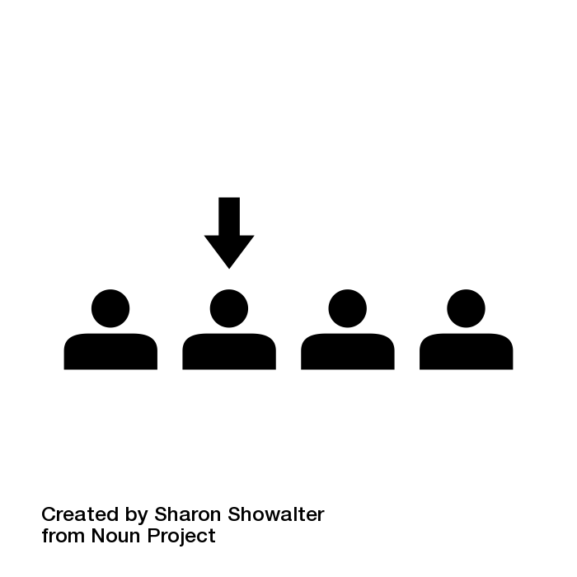
Recruit & Orient with Intention
Be purposeful about board composition
  Tie to your strategic plan
  Board Profile tool
Have a process for board recruitment
  Ex: Application, interview, observe board meeting
Seek or be a buddy to a new member
Have a board orientation
Notes:
10
28% of CEO’s rank changing or strengthening their recruitment practices third among areas most needing improvement.
Currently Bob is the board buddy!

Slide 11

Be Inclusive
Be engaged with your membership
Know yourself and face your own biases
Actively learn about those who differ
Get to know people
Notes:
11

Slide 12
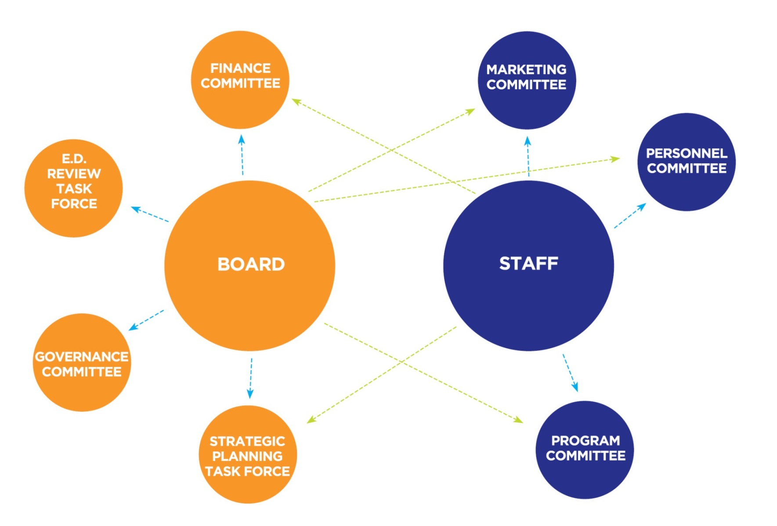
Encourage Effective Structure
Have board committees doing board work
Boards have an average of 4.8 committees
Notes:
12

Slide 13
Implement Strategic Practices
Engage in active learning
Conduct a board assessment
Board Development Plan:
  Revisit development opportunities
  Organize/prioritize
  Put into a board calendar
  Board committee advance this work?
51% of boards have conducted a self-assessment in the last 3 years
Notes:
13

Slide 14
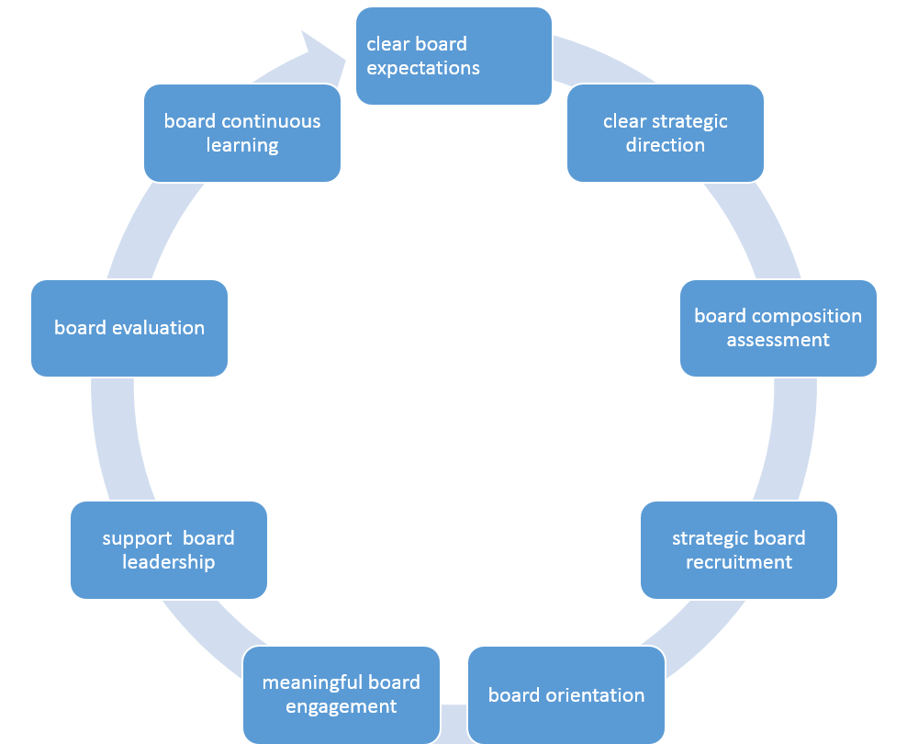
Board Development Process
Notes:
14

Slide 15
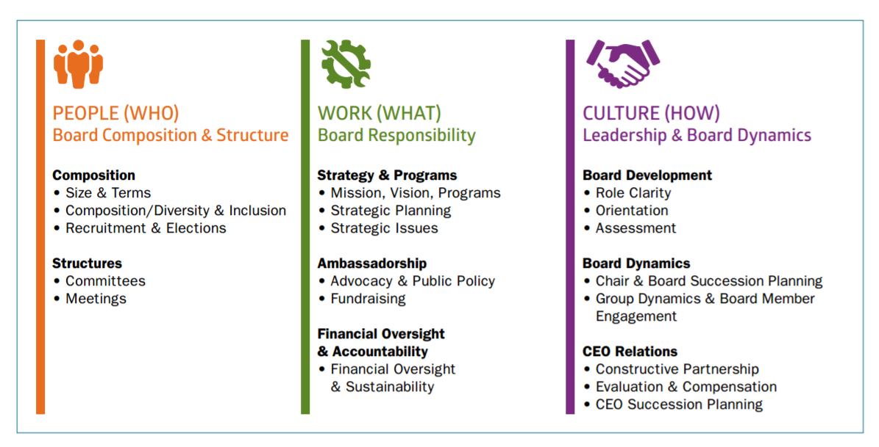
Implement Strategic Practices
From Board Source 2015 “Leading with Intent”
Notes:
15
Lenses to consider in your board development

Slide 16
Discussion Questions: Board Development Plan
Consider the following guiding questions as you consider your board’s work
What would success look like from our board in 2018?
What kind of agendas and tools would help us achieve success?
What barriers might surface? How might we overcome those?
How can we hold ourselves accountable?
How do we operationalize this/weave it into our board calendar?
Notes:
16

Slide 17
Large Group Discussion:
What squared with you?
Questions still circling?
Changes for your board?
Please fill out the workshop evaluation
Thank you!

